Slide 1



DECISION TREE

Slide 2
DECISION TREE
- ClAssification and Regression Tree (CART)

Slide 3
You are building a recommendation system and you are
suppose to provide recommendations of suggesting App
based on Gender and occupation
Which one you would suggest for the following people ?

Slide 4
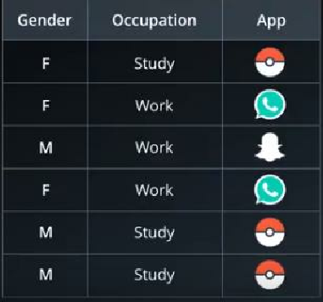
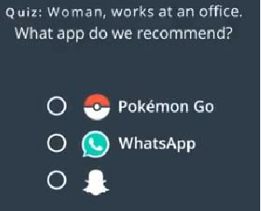
Recommendation System - 1

Slide 5
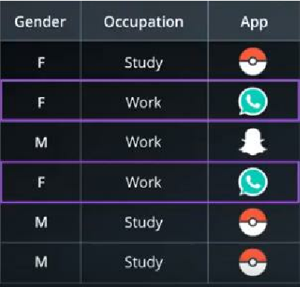
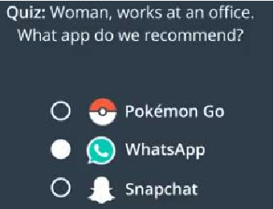

Slide 6
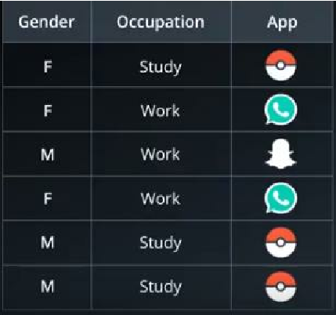
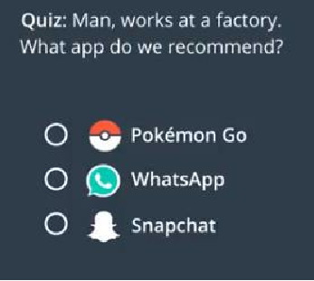
Recommendation System - 2

Slide 7
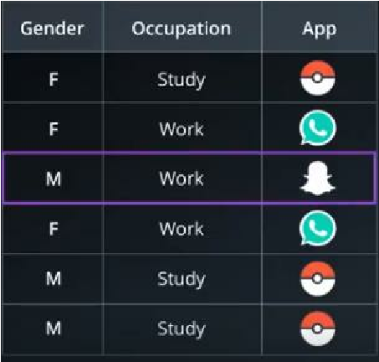
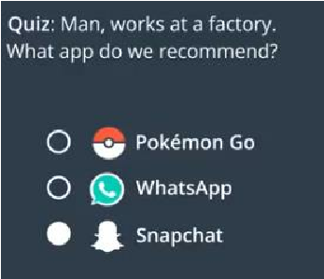

Slide 8
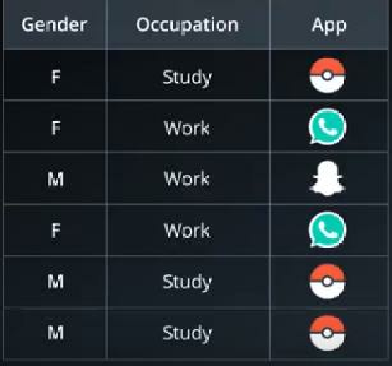
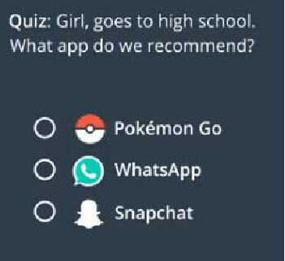
Recommendation System - 3

Slide 9
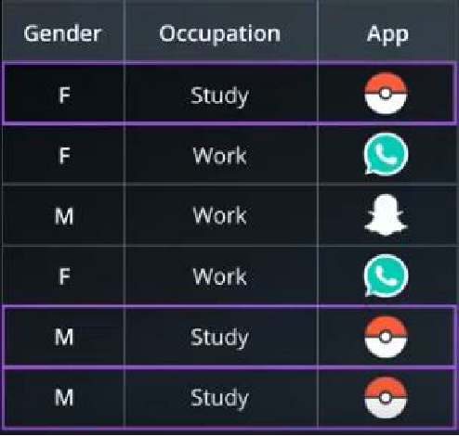
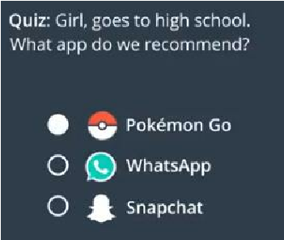

Slide 10
That was pretty Easy right …

Slide 11
That was pretty Easy right …
But what if we had to choose between Gender and
Occupation to suggest an App

Slide 12
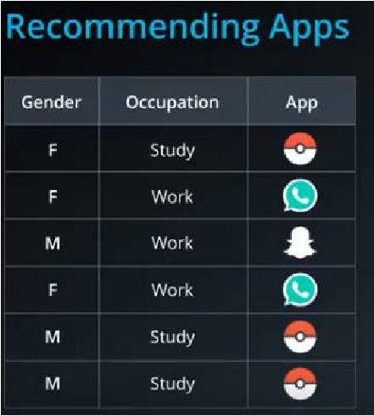
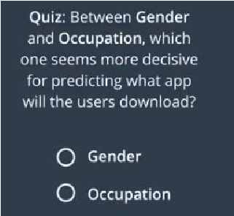
Way Machine approaches

Slide 13
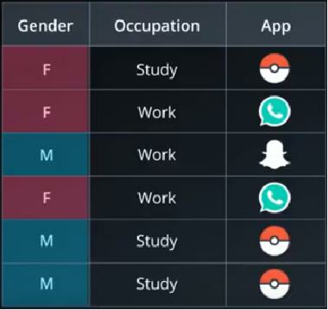
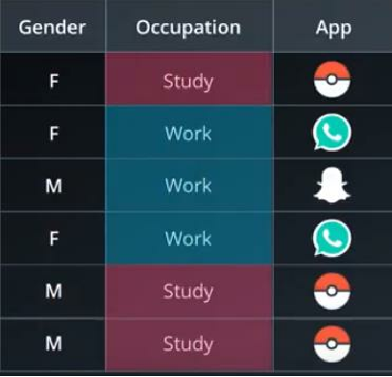

Slide 14
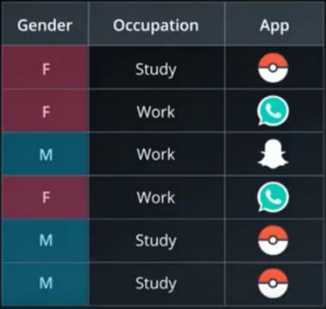
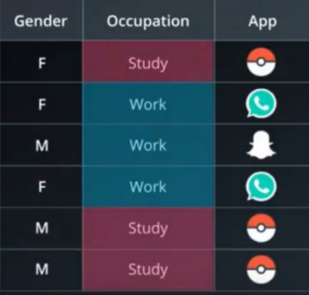
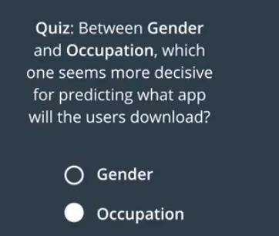

Slide 15
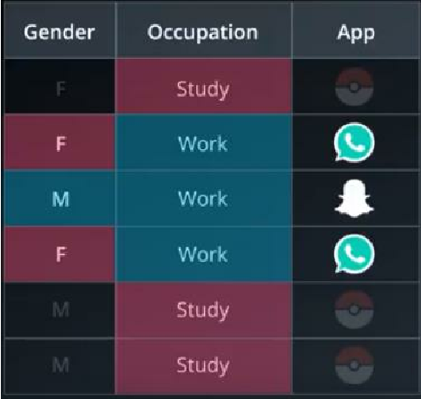
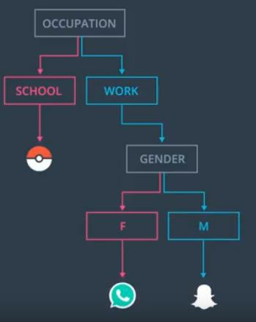
Construction of

Slide 16
Terminologies
Root Node
Decision node
Leaves

Slide 17
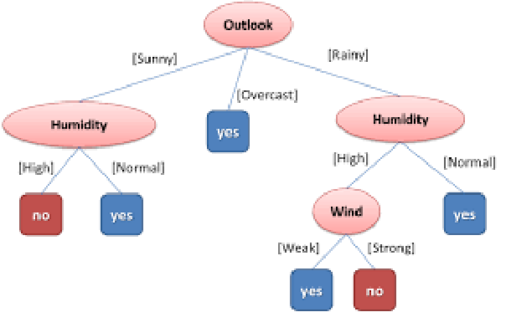

Supervised learning algorithm
Root Node -
Decision node -
Leaves -

Slide 18
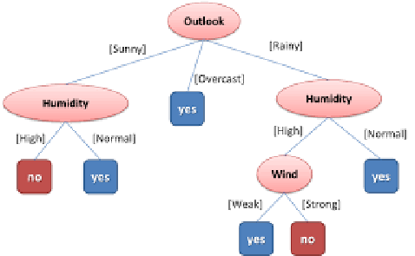
Supervised learning algorithm
Root Node - Outlook
Decision node - Humidity/Wind
Leaves - Yes/No

Slide 19
How do we find the Root node ?

Slide 20
HOW TO FIND ROOT (2 WAYS)
• Information gain
• Gini index

Slide 21
Understand Entropy you will get to understand
Information Gain

Slide 22
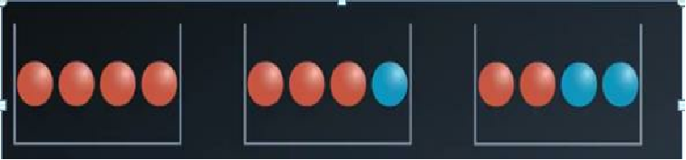
Entropy or Randomness
- The measure of uncertainty

Slide 23
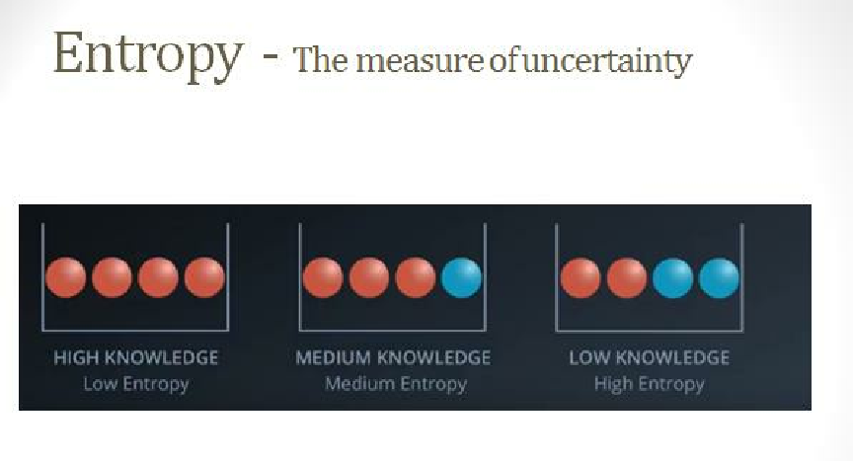

Slide 24
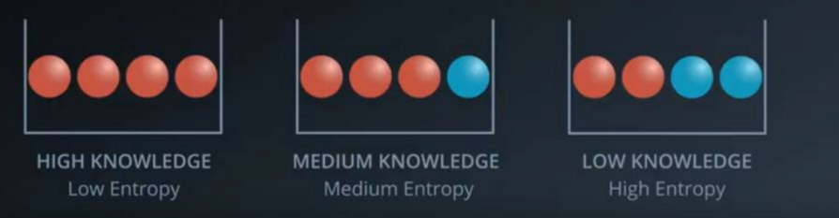
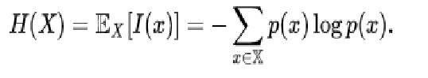
Entropy - The measure of uncertainty

Slide 25
Information Gain & Entropy
Information Gain -> Information theory -> Entropy
Entropy = Randomness or Uncertainty of a random variable.
There are 2 steps for calculating information gain for each
attribute:
➢ Calculate entropy of Target.
➢ Calculate the Entropy for every attribute.
Information gain = Entropy of target - Entropy of attribute

Slide 26
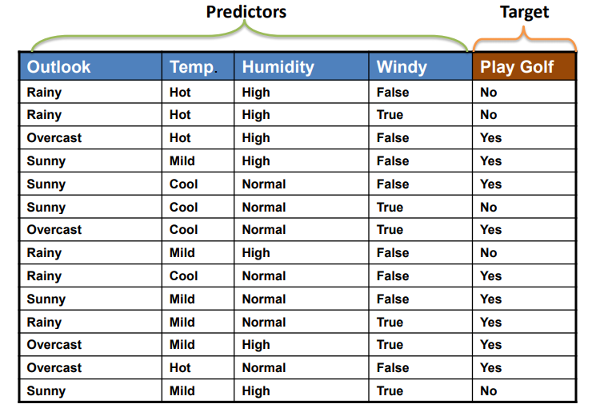
Case Study – Golf Play Dataset

Slide 27
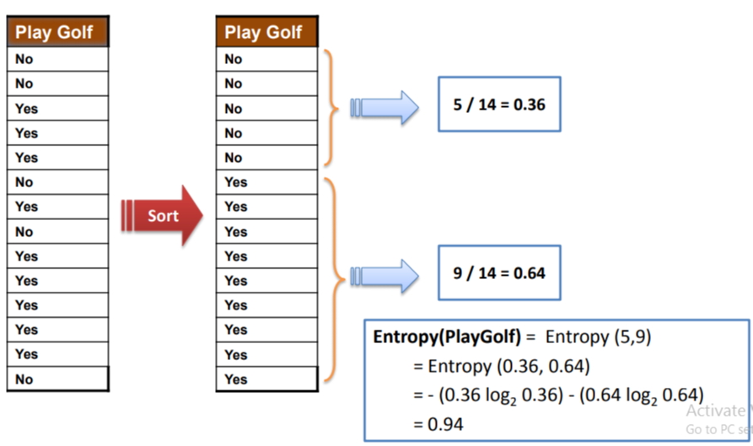
Entropy of Target

Slide 28
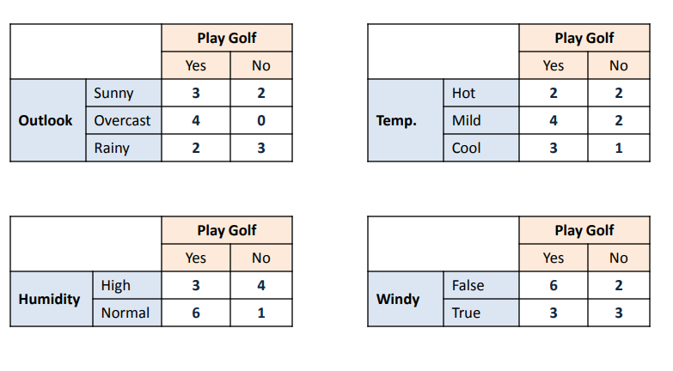
Frequency Table – 4 Attributes

Slide 29
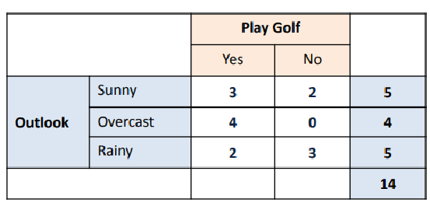
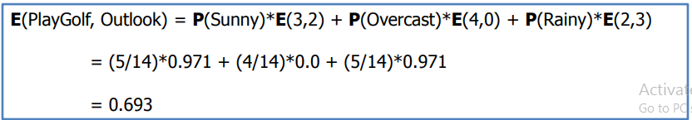
Entropy - Outlook

Slide 30
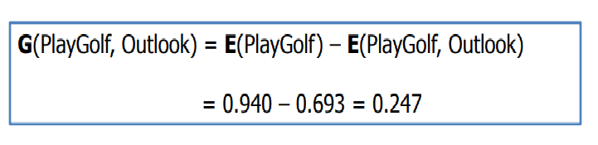
Information Gain - Outlook

Slide 31
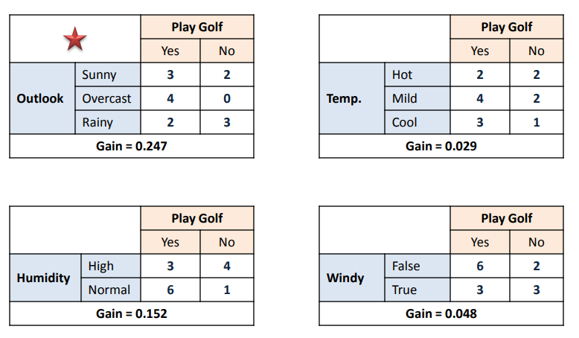
Information Gain - All Attributes

Slide 32
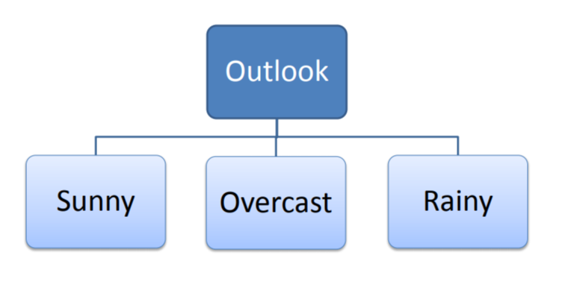
Construction of Tree

Slide 33
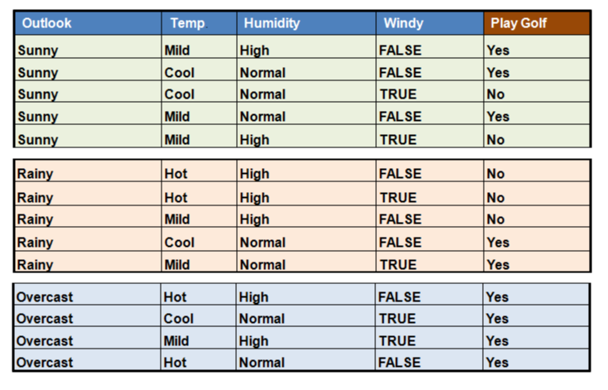

Slide 34
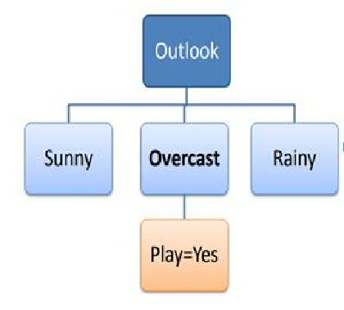
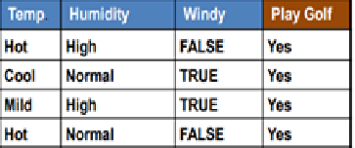
Overcast

Slide 35
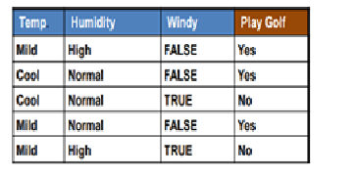
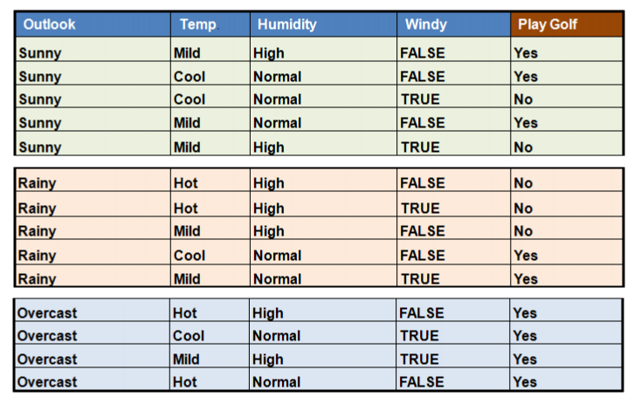
Sunny

Slide 36
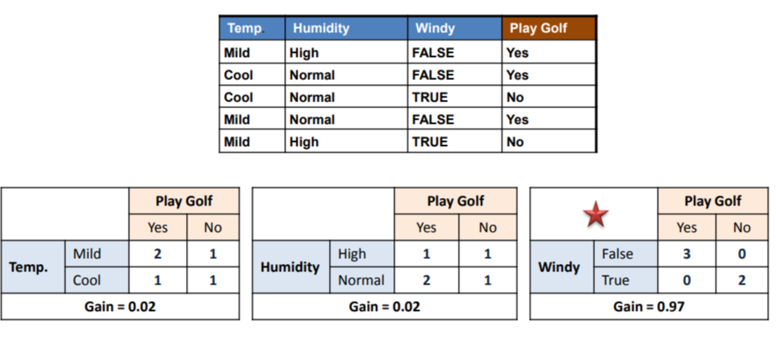
Sunny

Slide 37
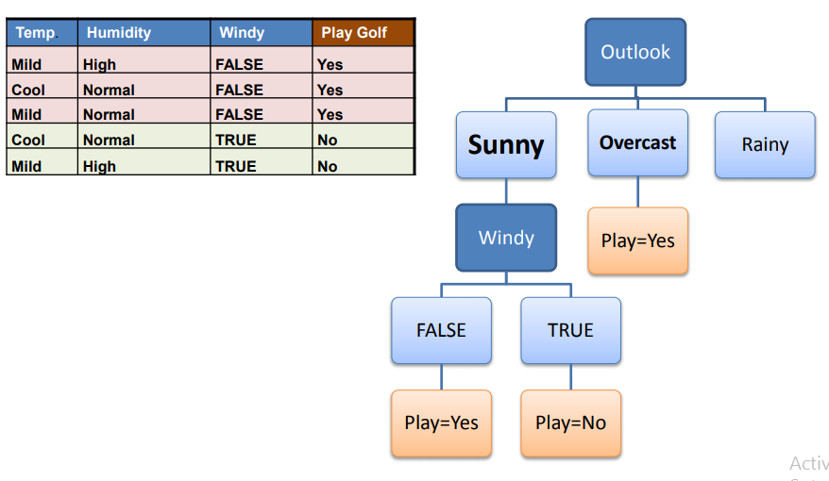
Construction of Tree

Slide 38
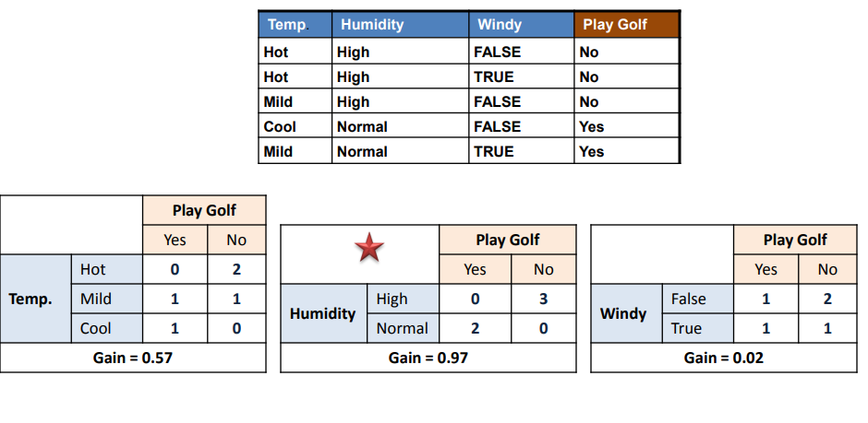
Rainy

Slide 39
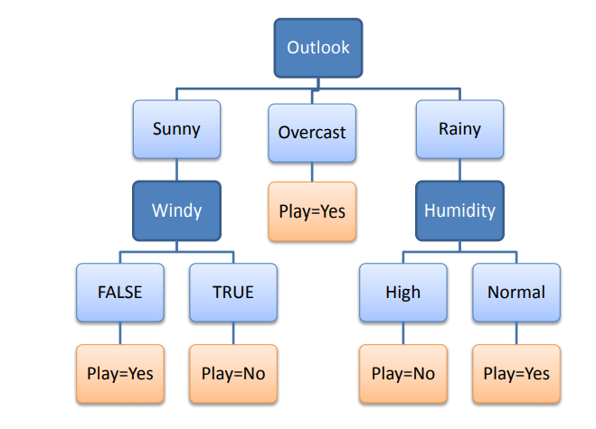
Final Tree Structure

Slide 40
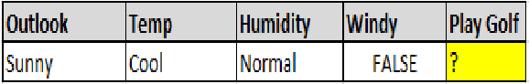
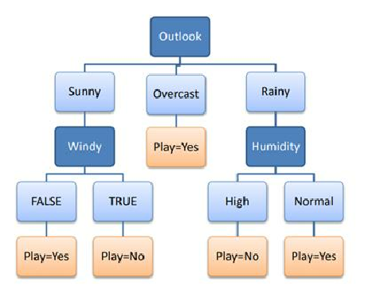
Predict the Play – D15 ?

Slide 41
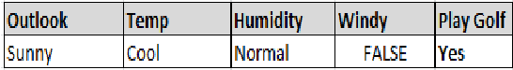
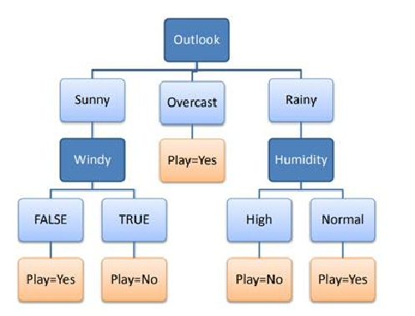
Predict the Play – D15 ?

Slide 42
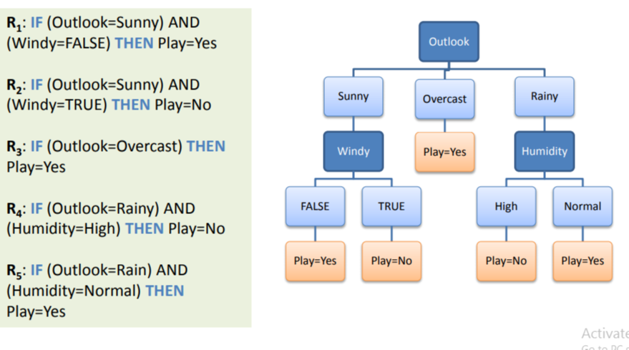
Decision Rules – Traditional approach

Slide 43
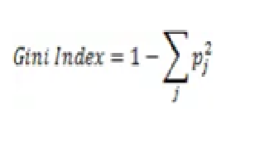
Finding Root using Gini Index
1.
The steps to build the tree using Gini Index approach is
same as the Entropy with the only change in the Formula.
2.
In Gini the attribute with the lowest Gini score is used as the
ROOT
3.
Gini Index is the default method of building the Decision
Tree

Slide 44



Continuous Data
Or

Slide 45


Horizontal vs Vertical

Slide 46
Horizontal vs Vertical
- Vertical seems to be Better as it has less errors

Slide 47


Construction of a Tree

Slide 48


Decision Tree – Manual Structure

Slide 49
Problem with Trees

Slide 50
Problem with Trees
How will a tree structure look if there are N columns

Slide 51

Problem with Trees
How will a tree structure look if there are N columns

Slide 52
Problem with Trees -
Overfitting
How will a tree structure look if there are 30 columns

Slide 53

When to stop splitting ?

Slide 54
Pruning -
To Avoid Overfitting

Slide 55
Pruning
1. Pre-pruning
2. Post-pruning

Slide 56
Ensemble

Slide 57
Ensemble
1.
Bagging
2.
Boosting
3.
Stacking

Slide 58


Ensemble
Machine learning paradigm which combine weak learners to
become a strong learner

Slide 59
Random Forest (Most used
algorithm)

Slide 60
Random Forest (Most used
algorithm)
- Bagging Technique (
B
ootstrap
agg
regat
ing
-
B
agging
)

Slide 61


Slide 62


Slide 63


HOW THE RANDOM FOREST ALGORITHM
WORKS IN MACHINE LEARNING
- Supervised learning algorithm
- Regression and classification problems

Slide 64

Bagging

Slide 65
Random Forest pseudocode
• Randomly select “k” features from total “m” features.
Where k << m
For classification a good default is: k = sqrt(m)
For regression a good default is: k = m/3
• Among the “k” features, calculate the node “d”.
• Split the node into daughter nodes.
• Repeat 1 to 3 steps
•
Build forest by repeating steps 1 to 4 for “n” number times to
create “n” number of trees.

Slide 66
Key Points
•
Majority voting.
•
Higher the number of trees in the forest = High accuracy.
•
When we have more trees in the forest, random forest
classifier won’t overfit the model.
● For each bootstrap sample taken from the training data,
there will be samples left behind that were not included.
These samples are called Out-Of-Bag samples or OOB.
•
The performance of each model on its left out samples when
averaged can provide an estimated accuracy of the bagged
models. This estimated performance is often called the OOB
estimate of performance.

Slide 67

Random Forest - Skeleton

Slide 68
Boosting

Slide 69

AdaBoost (Adaptive Boosting)

Slide 70

AdaBoost – Pattern 1

Slide 71

AdaBoost – Pattern 1

Slide 72

AdaBoost – Pattern 2
Apply pattern 2 on the Input Data from pattern 1

Slide 73

AdaBoost – Pattern 2
Input Data

Slide 74

AdaBoost – Pattern 3
Apply pattern 3 on the Input Data from pattern 2

Slide 75


AdaBoost – Pattern 3
Input Data

Slide 76




AdaBoost – Pattern 1
Weights after applying pattern 1

Slide 77




AdaBoost – Pattern 2
Weights after applying pattern 2

Slide 78


AdaBoost – Pattern 3
Weights after applying pattern 3

Slide 79

AdaBoost – 3 Models

Slide 80

Weightage of a Model

Slide 81

Weight of Model 1

Slide 82

Weight of Model 2

Slide 83

Weight of Model 3

Slide 84

Weight of 3 Models

Slide 85

Assigning weights to 2
categories

Slide 86

Model 1

Slide 87


Model 2

Slide 88


Model 3

Slide 89

Sum of All weights

Slide 90


Slide 91


Slide 92

Final Output

